Slide 1
Categorization based on Company Activities
Martin Repka, Ján Paralič
Katedra kybernetiky a umelej inteligencie
Fakulta elektrotechniky a informatiky
Technická univerzita v Košiciach
{Martin.Repka, Jan.Paralic}@tuke.sk

Slide 2
Company Network
publicly accessed sources as Business Register of Slovak Republic (ORSR)
aggregated, analyzed and integrated within project ITLIS¹
featuring complete data model, which integrates structural, compositional and temporal (historical) data
aim
correlation between compositional data and online catalogue categories
¹ www.itlis.eu

Slide 3
Data
Amadeus - compositional data about 25683 companies
Azet - online catalogue entries in 15705 cases
Itlis - companies in 10 largest online cat. categories,
2040 companies (ranging from 105 to 389 companies in category)

Slide 4
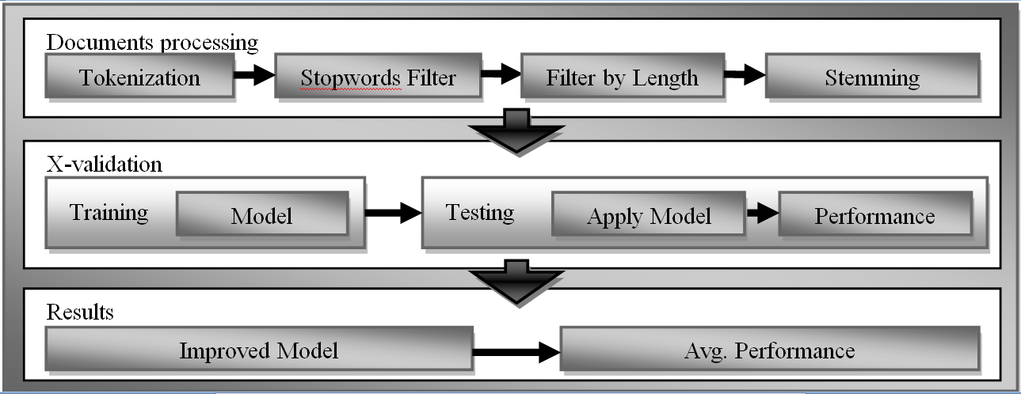
Company categorization
classification of documents into categories
Text-mining technique
List of company activities as unstructured document

Slide 5
Results
average accuracy
10-fold cross-validation
average performance using mode values = 19.07%
RapidMiner

Slide 6
Conclusions
data integration from several sources
experimentally verified correlation of compositional data (company activities) and online categorization
several model learners
time complexity and model accuracy
very efficient model learners seems to be SVM, Neural Network and Naive Bayes (Kernel) model
information could be useful as support to other analyses of company network.

